Slide 1

New York State Regionalization Initiative
June 2024

Slide 2
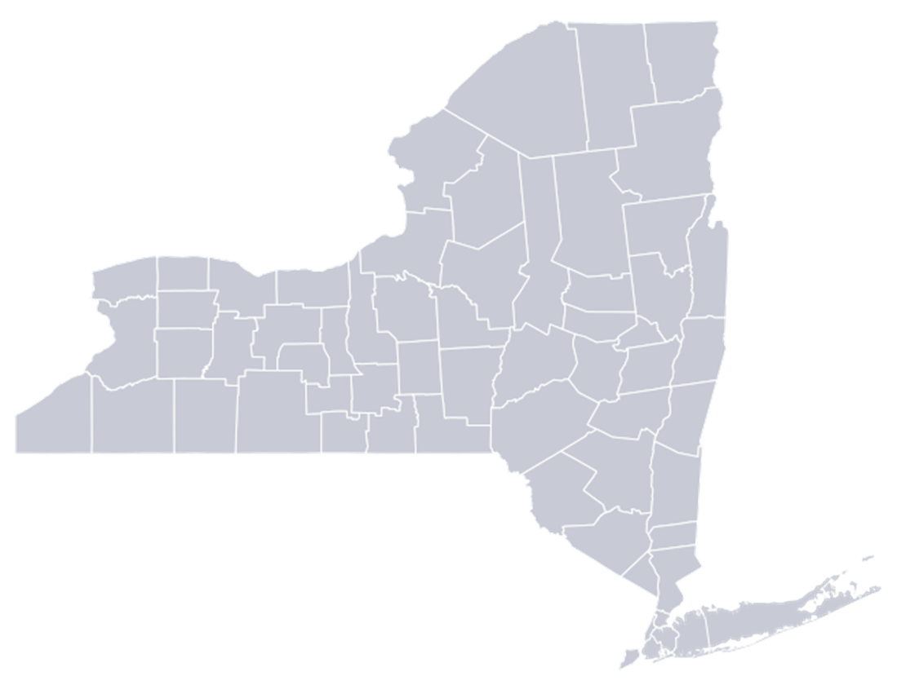


Challenges for School Districts
New York State is facing significant challenges within and across communities to preparing all students for college, career, and civic readiness, including:
Student access to high-quality educational opportunities
Fiscal concerns

Slide 3
Regionalization as an Opportunity and Strength
Regionalization is a collaborative model for addressing student needs and exploring operational efficiencies where districts can engage in conversations and partner with others around a variety of solutions, such as:
Advanced Coursework
Shared Staff
Extracurricular Activities
Range of Subject Areas
Regional Industry Partners
Shared Student Support Services

Slide 4





Guiding Principles
Regionalization is not reorganization
Time to act is now
Local solutions are needed for local problems
Collaboration is essential in a 21st century global economy
No single district can engage in this work alone

Slide 5
Regionalization Plan
Needs Assessment
The New York State Education Department will require all districts in a Sole Supervisory District to work with the local District Superintendent to create a regionalization plan (37 total plans) that creates educational opportunities for all students.
Implementation
Convenings
10-Year Cycle
Regionalization Plan
Interim Progress Report
Notes:
There are currently many bright spots, where districts can build on really good things happening across the state.

Slide 6
Timeline
Regionalization Plan Development Step | Deadline
Needs Assessment | November 1, 2024
Convenings Facilitated by District Superintendents | First Convening by November 1, 2024
Interim Progress Report | April 1, 2025
Final Regionalization Plan | October 1, 2025

Slide 7
Key Roles
NYSED
District Superintendents
Districts
  Creates templates.
  Provides data and technical assistance.
  Modifies policy to support innovative ideas.
  Advocates for resources.
  Convenes regionalization conversations.
  Faciliates the completion of each step, including the final plan.
  Shares data and district ideas across the region.
  Participates in each step.
  Engages in conversations with districts and stakeholders, generating ideas and responding to feedback and data.

Slide 8



Benefits
Create equitable educational opportunities for all students.
Establish a systematic mechanism for districts to engage in continual improvement.
Develop a model for addressing ongoing educational and fiscal challenges.

Slide 9



Next Steps for Regionalization
Collect stakeholder feedback and talk with districts/BOCES.
Create the needs assessment template.
Develop a regulation on the 10-year regionalization planning cycle.

